Slide 1
Object Oriented Programming
Bekmyradov, Vekil 11266066
Liu, Szu-Yu 11246693
Saki, Maryam 11247400
Wang, Ruohan 11257552
08, 04, 2024

Slide 2
Outline
Introduction
Software Architecure
GUI
Classification
Regression
Future Works

Slide 3
Introduction
Creating Optimal Classification and Regression models for given datasets
Utilizing OOP concepts for optimal and robust software
Writing tests to deliver the fully functional software
Building fast and intuitive user interface for better user experience

Slide 4





Software Architecture
Project Structure (git, github, venv, pep8)
User Interface Module (streamlit, seaborn, matplotlib)
setting different components (buttons, selectors)
execution of main ML model package functionality based on selected configuration options
Main ML model package (scikit-learn, pandas, numpy)
classification and regression logic
helper functions and constants
Testing (unittest)
reference:https://git-scm.com/
https://pandas.pydata.org/
https://streamlit.io/
https://numpy.org/
https://scikit-learn.org/stable/

Slide 5
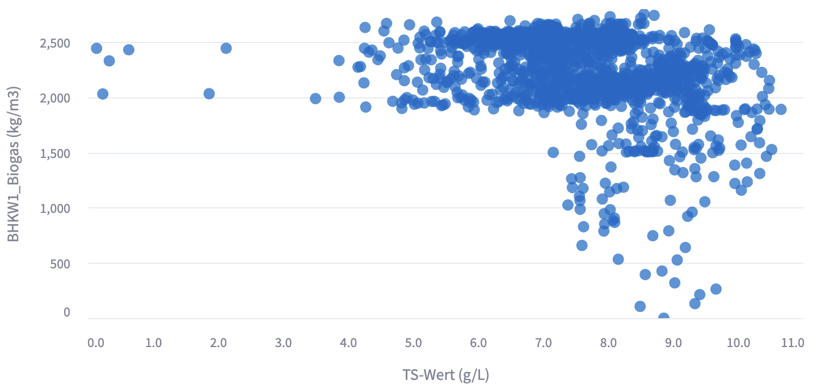
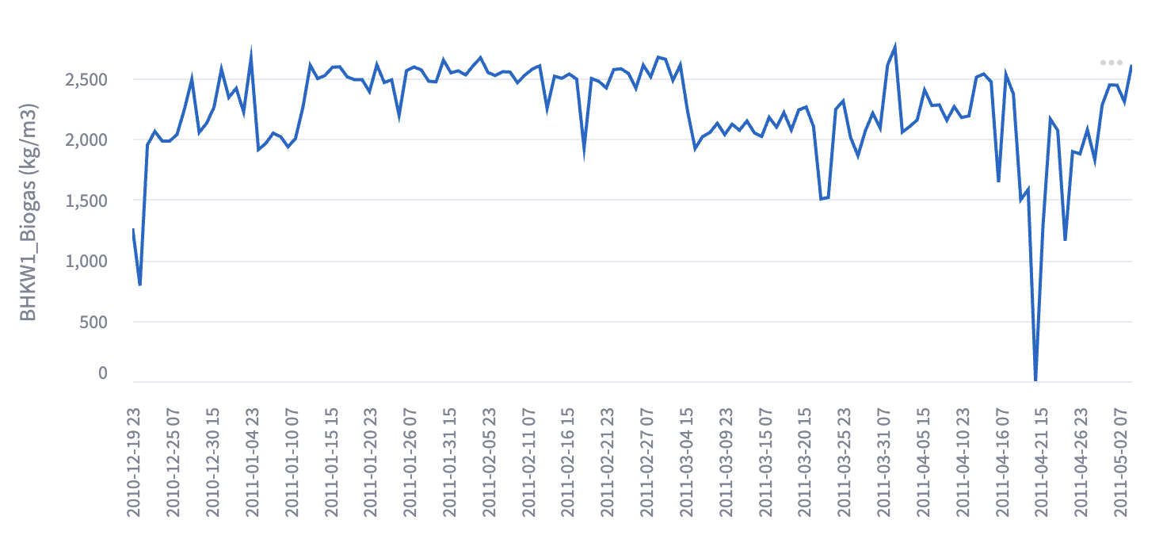
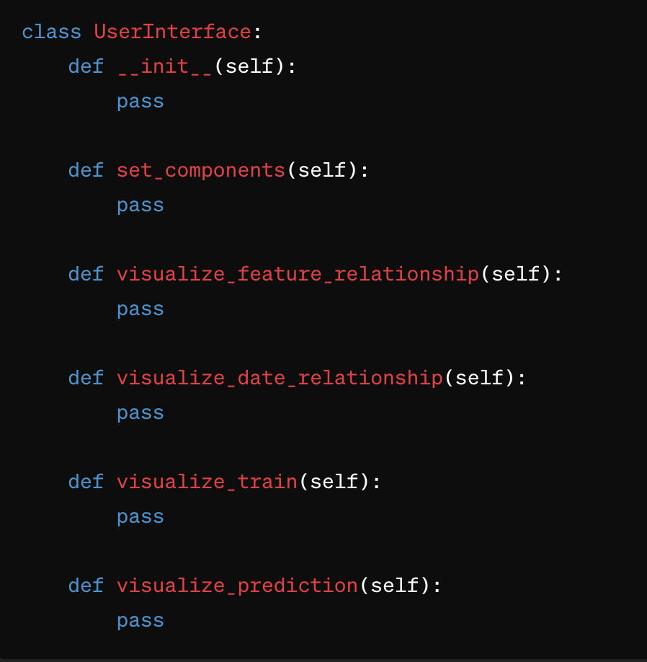
User Interface
Initialization (Constructor)
Setting up layout. Ex: buttons and selectors. Store user selected states
Show the relationship between different input and output features
Show the relationship of all features relative to date
Show the results of the training.
Ex: plots and evaluation metrics
Show the results of the prediction on test data.
Ex: Plots and evaluation metrics

Slide 6
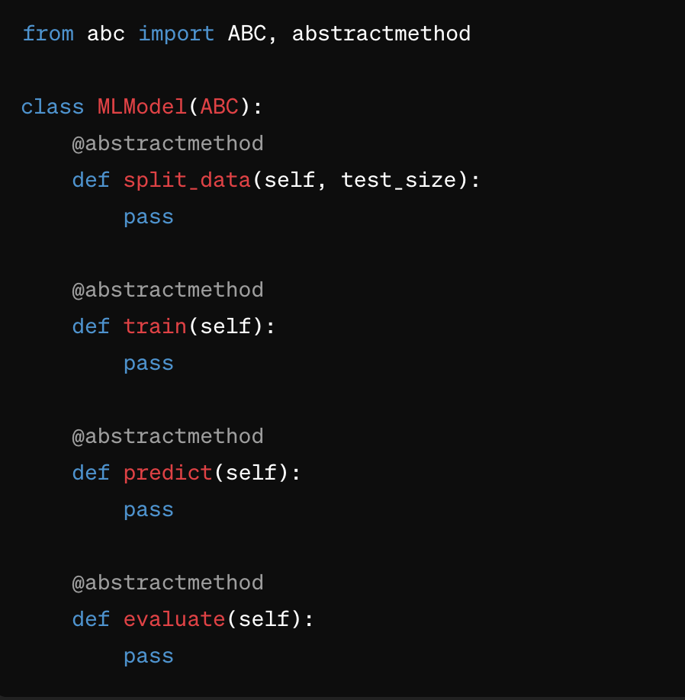
ML Model (Abstract class)
Initialize required variables and parameters (Constructor). Ex: self.X_test, self.model
Splitting the data according to given arguments. (Test size in percentage)
Train the data based on kernel or polynomial degree argument
Prediction based on test data
Define evaluation metrics like mean squared error and confusion matrix

Slide 7
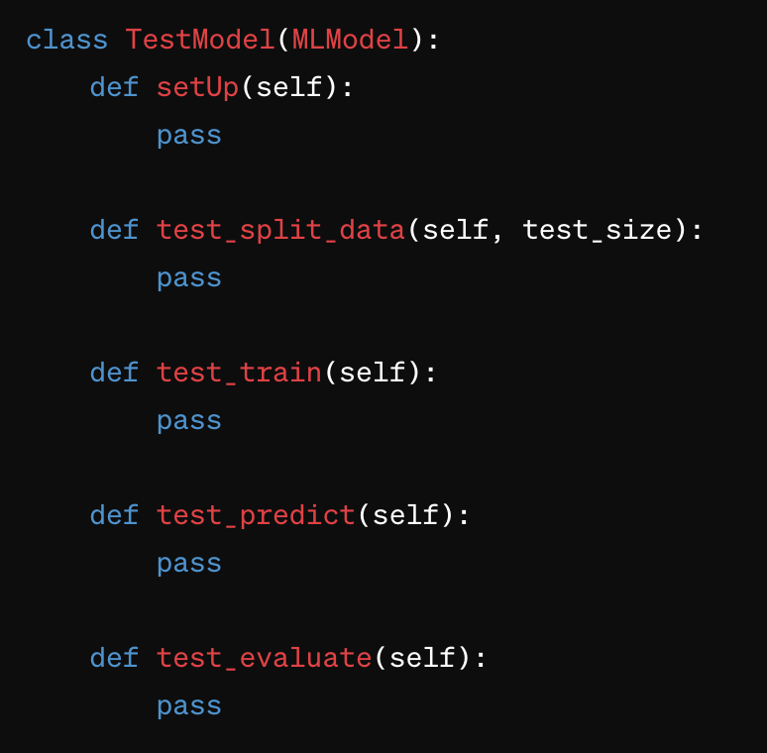
Testing
Setting up model entities for test
Testing whether data is split according to parameters
Check if the data shape matches given parameters after train
Check if the prediction has the shape according to given parameters
Test if the evaluation return expected results

Slide 8

GUI
Library of GUI (Graphical User Interface)
Simplicity
Fast prototyping
Integration with data tools
Automatic widget generation
sharing and deployment
reference: https://streamlit.io/

Slide 9
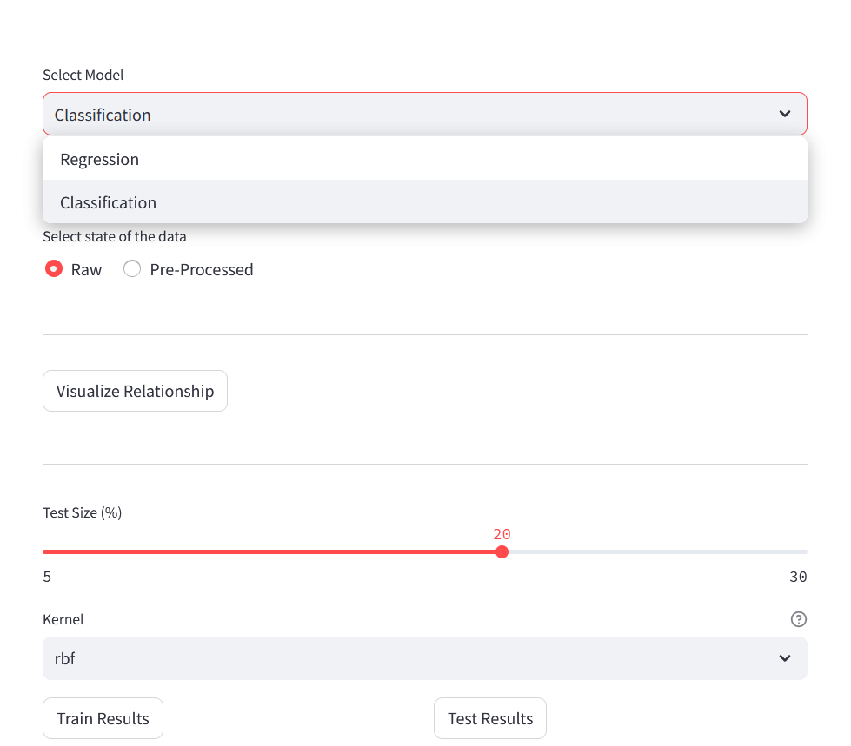
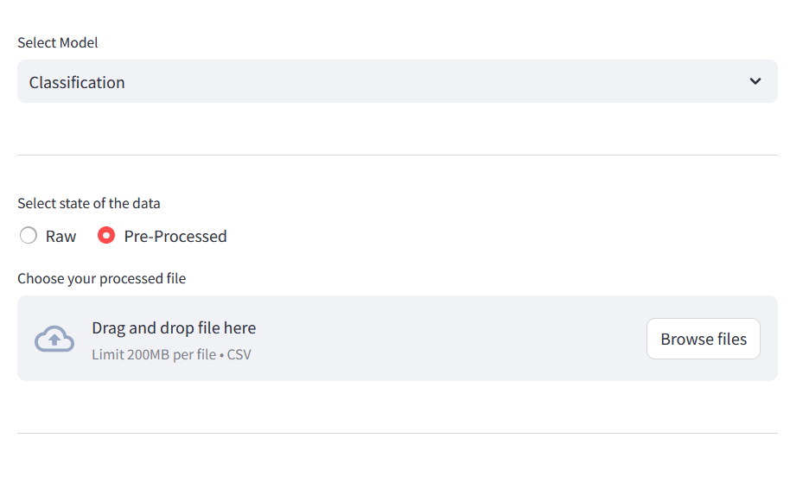
Configuration of GUI (Graphical User Interface)
raw
processed

Slide 10
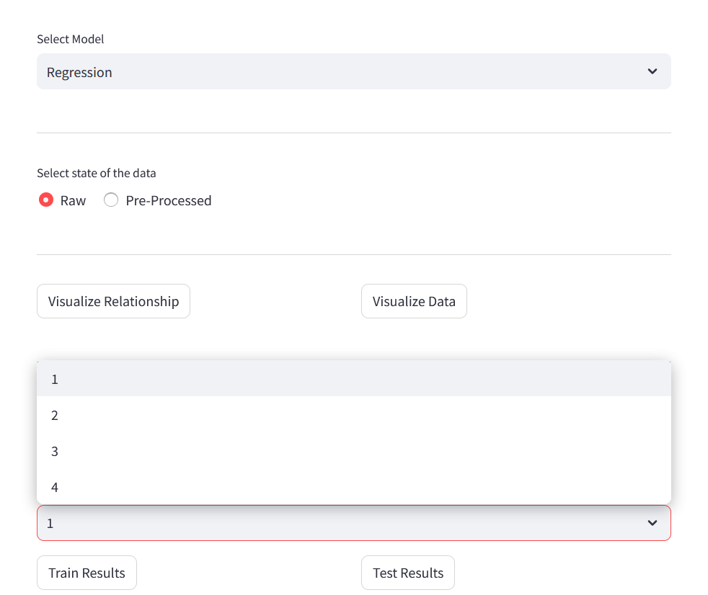
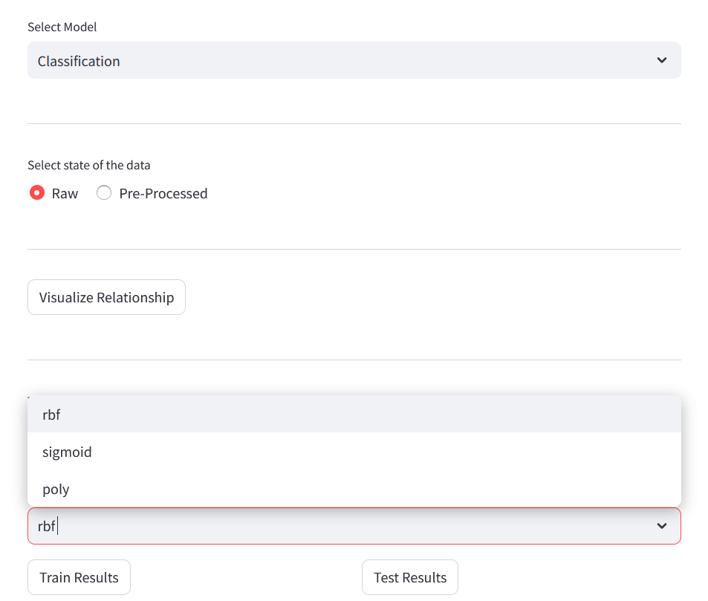
Configuration of GUI (Graphical User Interface)
Regression
Classification

Slide 11
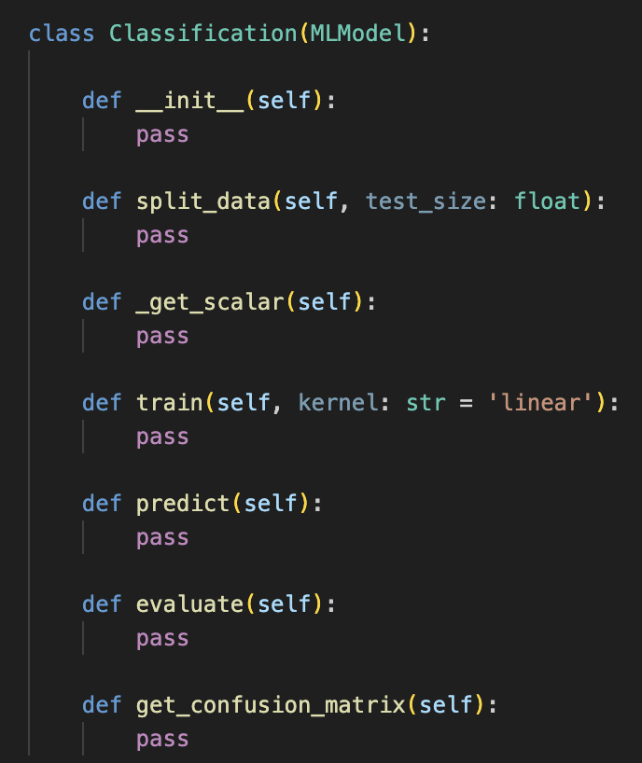
Classification
Architecture
__init__()
split_data()
_get_scalar()
train()
predict()
evaluate()
get_confusion matrix()
Notes:
從GUI拿到的參數

Slide 12
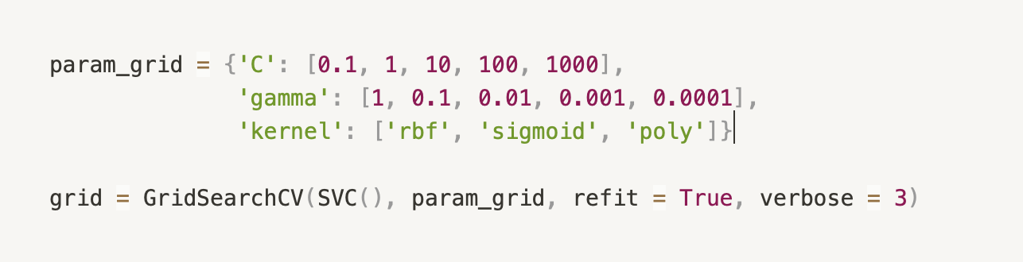
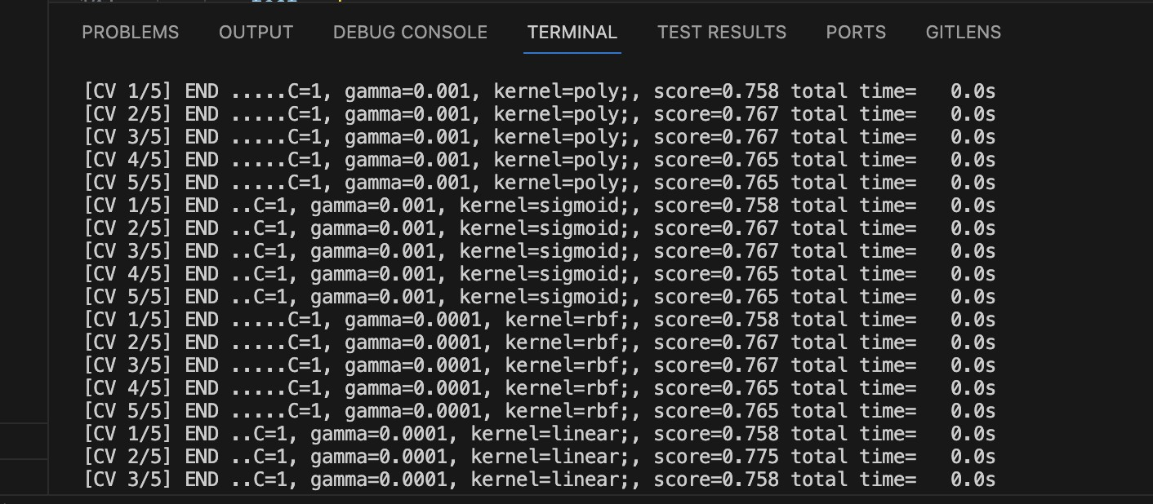
Classification
Kernel
rbf
sigmoid
poly
Notes:
從GUI拿到的參數

Slide 13
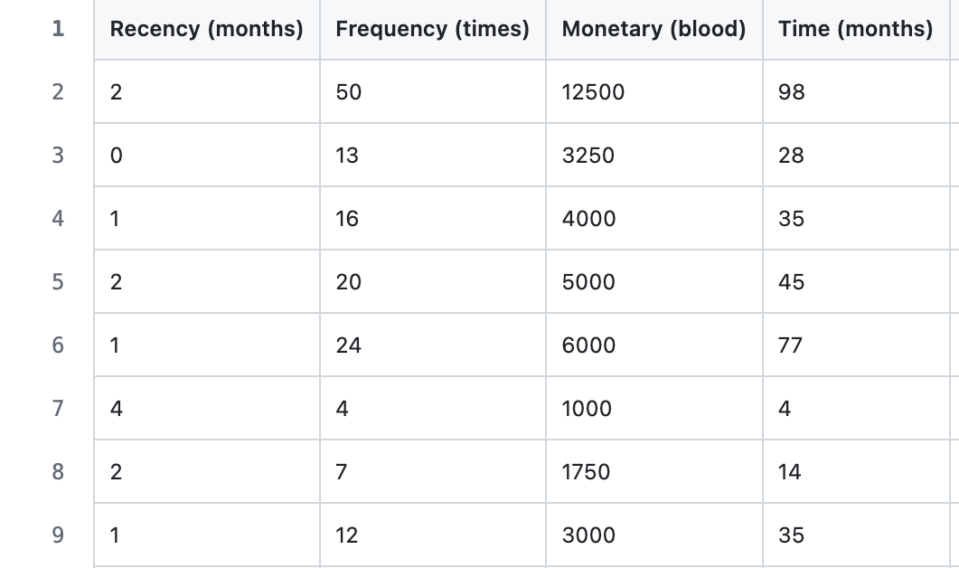
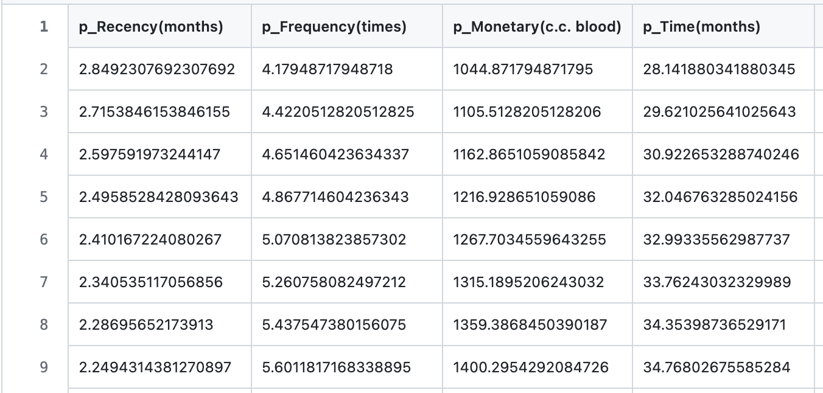
Classification
raw
processed

Slide 14
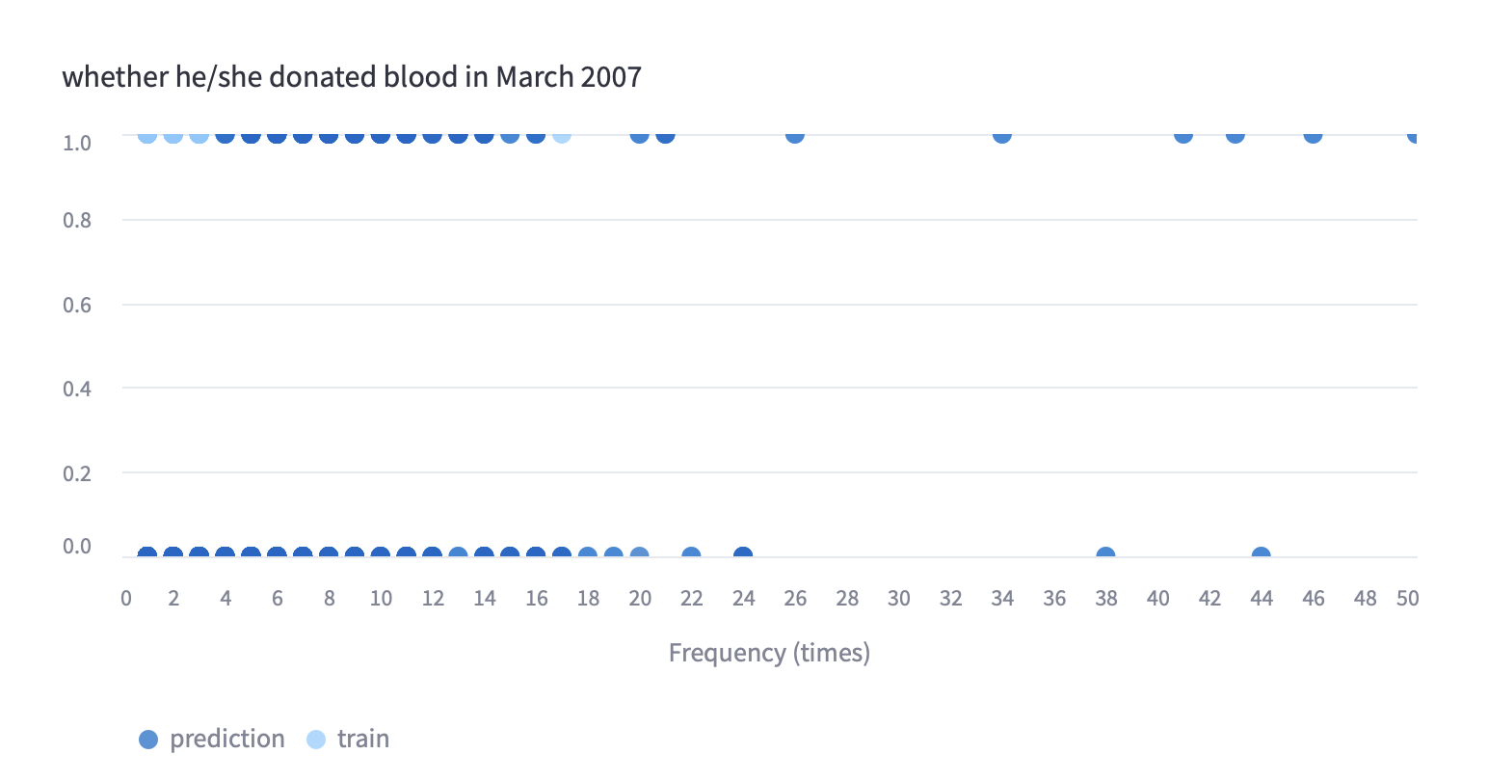
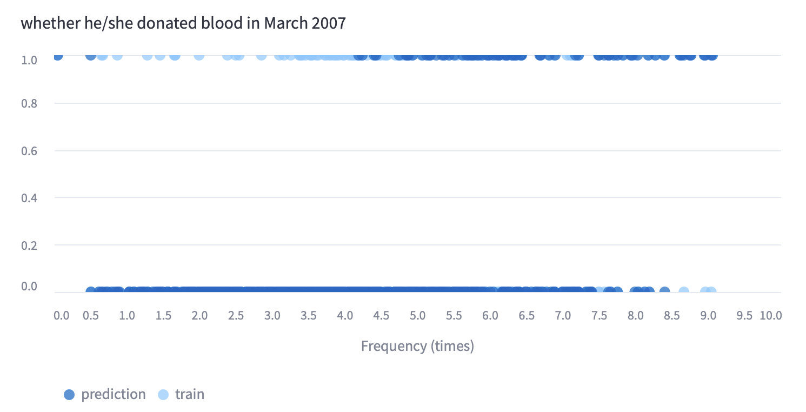
Classification
raw
processed

Slide 15
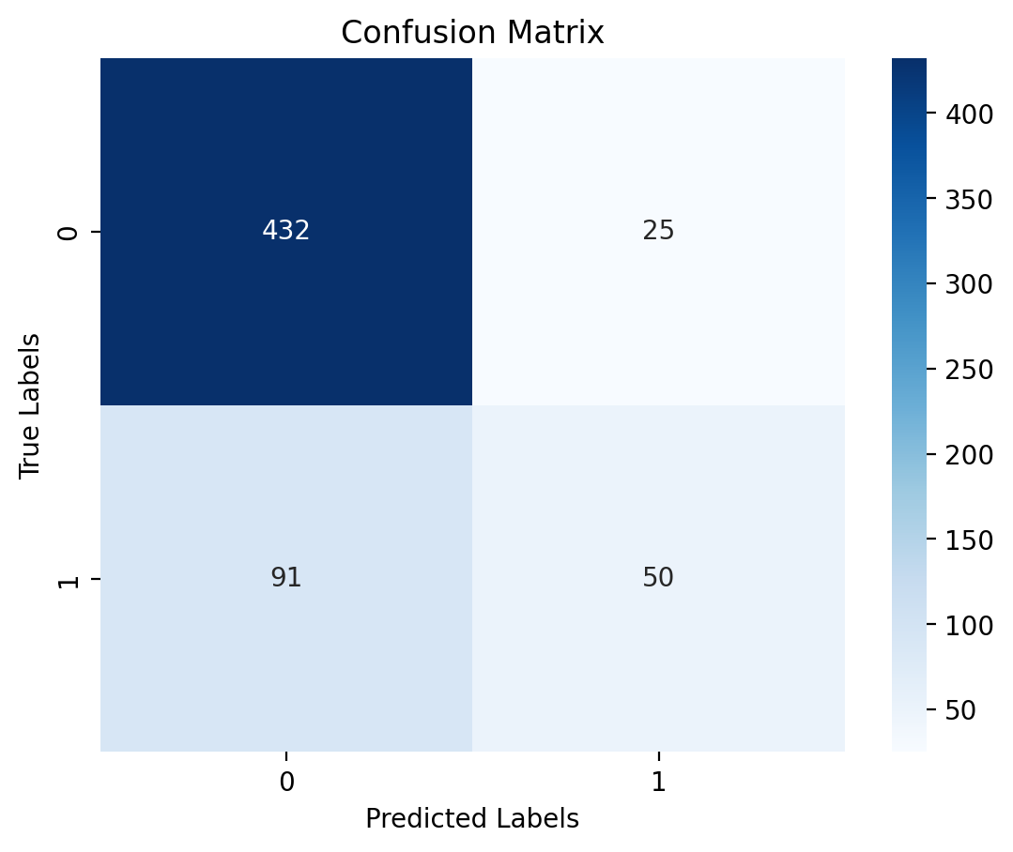
Classification
Kernel = rbf, test size = 0.2
Accuracy: 0.806
Kernel = sigmoid, test size = 0.2
Accuracy: 0.765
Kernel = poly, test size = 0.2
Accuracy: 0.77

Slide 16
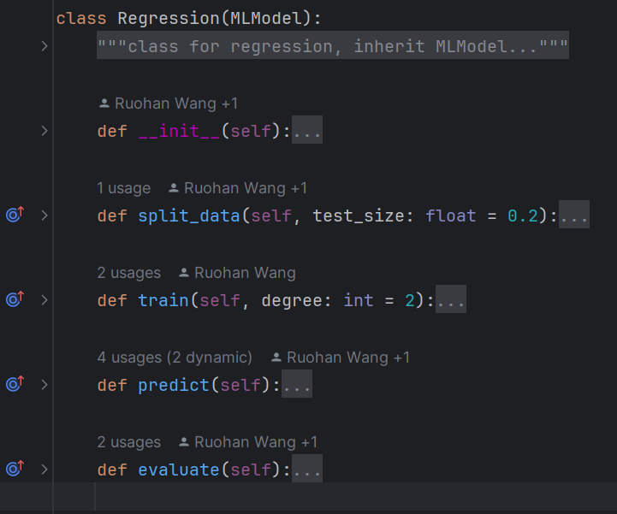
Regression
Architecture
__init__()
split_data()
train()
predict()
evaluate()
Notes:
__init__: read data from csv file
split_data: gets test_size from GUI and split the data into train and test
train: trains the model
predict: predicts the result of the test data
evaluate: shows how well the model fits the data

Slide 17
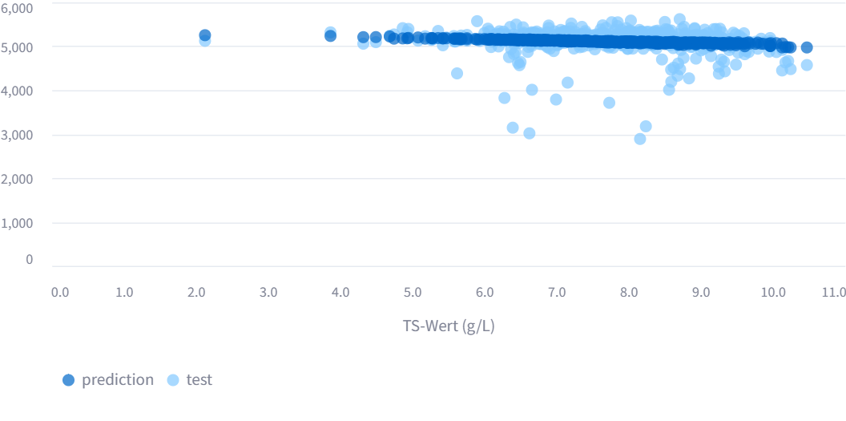
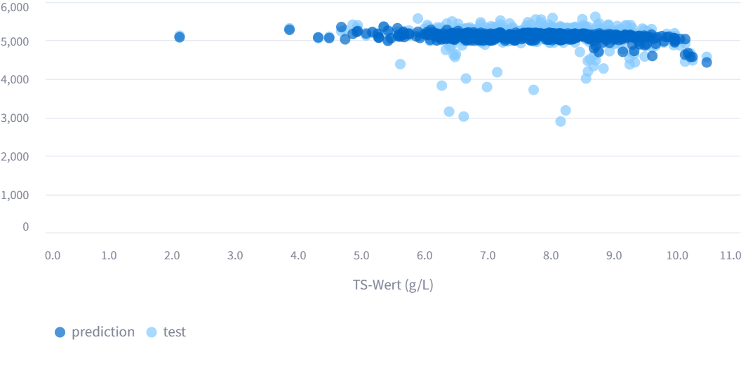
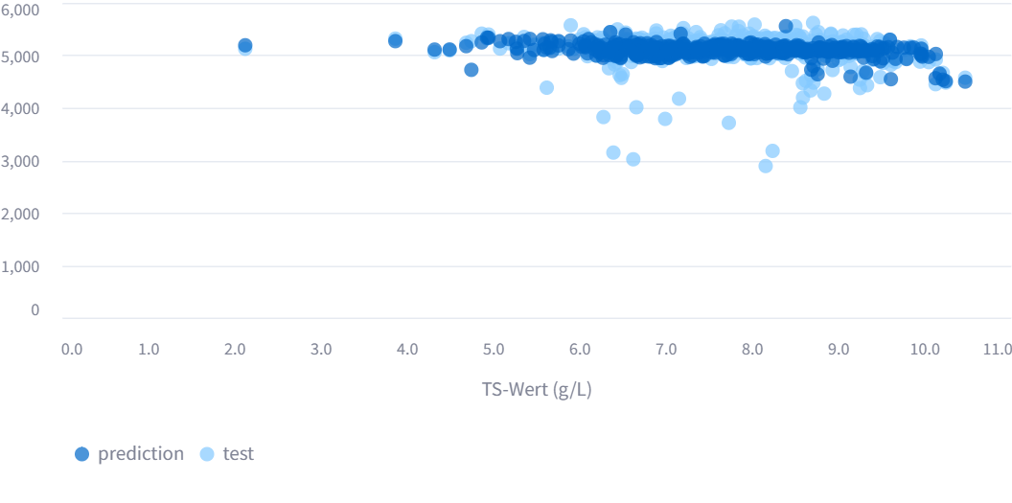
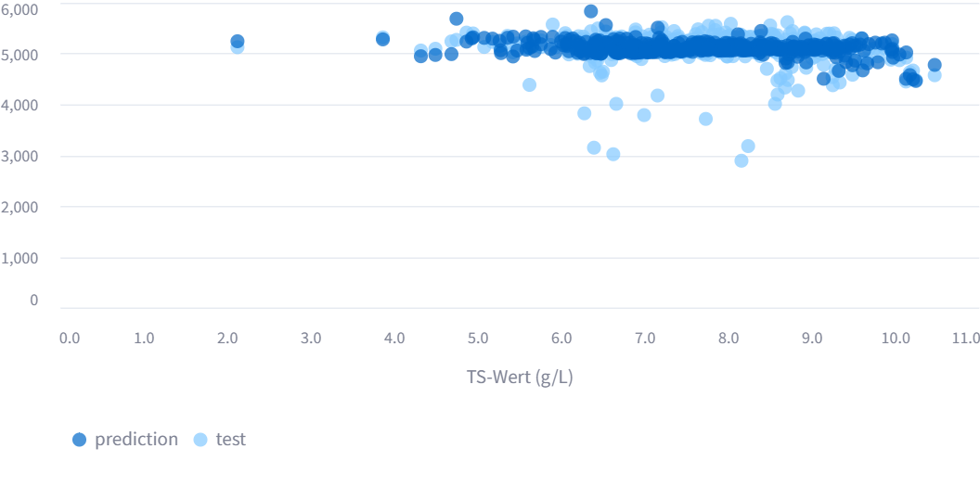
Regression
Degree
linear regression
polynomial regression
2，3，4
Notes:
take the biogas2 and TS-Wert test result as an example:
as it is shown in the above, linear regression is underfitted, when degree = 4, it has a little overfitted.

Slide 18
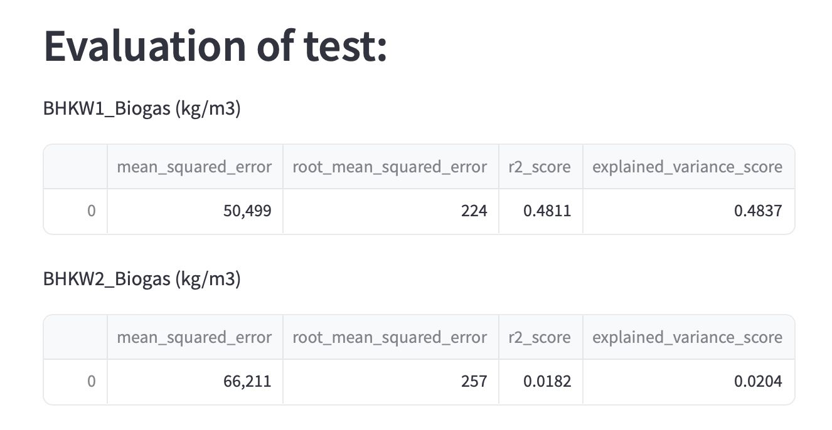
Regression
mean squared error
root mean squared error
r2 score
explained variance score
Notes:
This is the evaluation of raw data.
mean squared error and root mean squared error calculate the distance between real values and predicted values, the smaller the better
r2 score and explained variance score show the goodness of fit, more close to 1, the goodness of the fit will be better

Slide 19
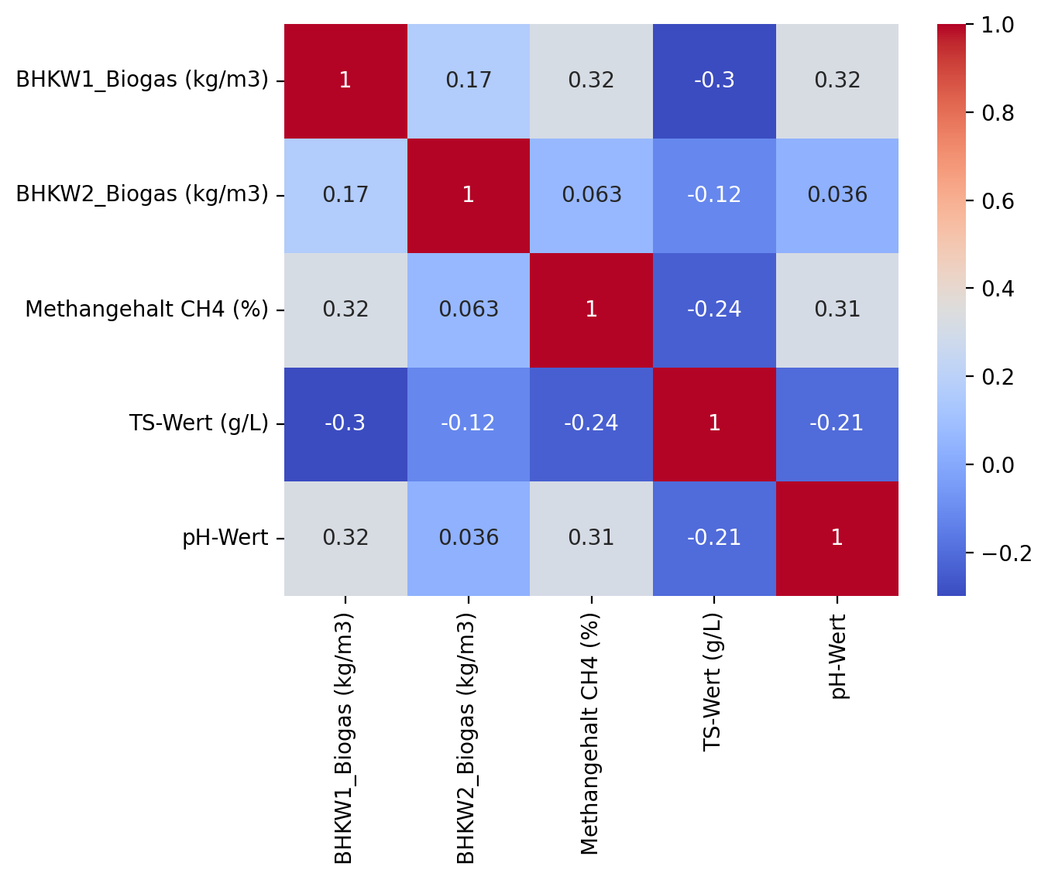
Regression
Correlation Matrix
Evaluation of Raw
Notes:
from the correlation matrix we can see biogas 1 has some relationship with 3 input features. biogas 2 has almost no relationship with all the input features which means no matter what regression method we use the result won’t be good. that’s also shown in the evaluation.

Slide 20
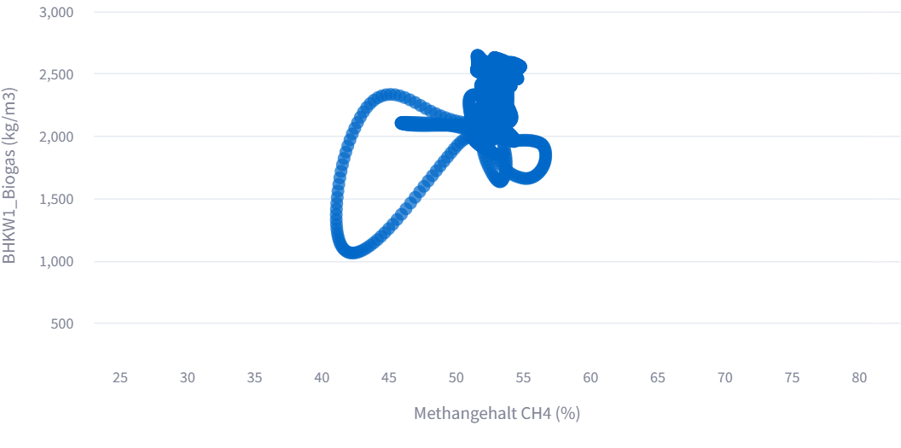
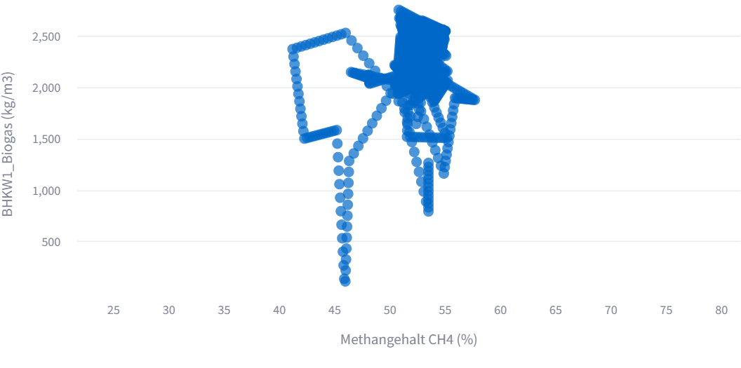
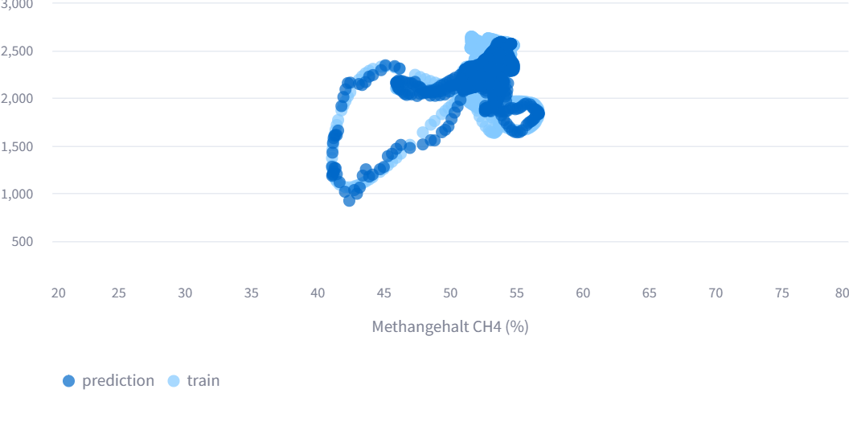
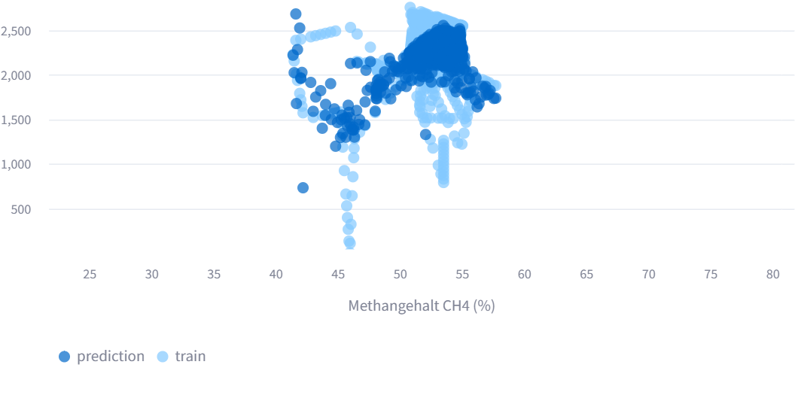
Regression
raw
processed
Notes:
we got one example file from group b. the degree of regression is 3 and test_size is 20%. from that certain file we can see data got distortion and no much characteristics are left there.

Slide 21
Future Works
Results depend on various factors such as data processing and optimal parameters for specific algorithms
Save the best performing models for further usage
Saving the data in database for more convenience access and manipulation

Slide 22
THANKS FOR YOUR
ATTENTION

